Slide 1

Qué aportan los marcadores bioquimícos en el manejo de la enfermedad cardiovascular? Troponina, Péptidos Natriuréticos y GDF-15
M. Jose Ramírez
22/01/2020

Slide 2



Marcadores cardiacos: Troponinas

Slide 3
POR QUE?
El diagnóstico y el descarte de IAM es un reto.
Interpretación adecuada de las concentraciones de Tn´s en el contexto clínico del pacientes
Mejorar el diagnostico diferencial de SCA.
PARA QUE?
ALGORITMOS para el diagnóstico del Infarto agudo del miocardio en urgencias
Recomendaciones consensuadas para interpretar las concentraciones de Tn´s en la sospecha del IAM
Notes:
Proteina formada por tres subunidades: Troponina C fija el Ca, troponina T fija el complejo troponina a la tropomiosina, TnI inhibe la unión complejo troponina-tropomiosina

Slide 4
Inmumoanálisis para medir Tn´s
Medir el percentil 99 con una imprecisión ≤ 10% expresada como coeficiente de variación (14ng/L)
Existen 2 métodos en función de:
La imprecisión analítica medida en el p99
El % de sujetos sanos que presentan concentraciones de Tn´s superiores al límite de detección del método (5 ng/L)
De Alta sensibilidad (hs Tn´s)
Contemporaneas
Ventajas de hsTn´s
Detecta concentraciones de Tn´s al menos 10 veces inferiores
Identifica más pacientes y de una manera más precoz (Algoritmos: 0, 0/1,0/2, 0/3 horas)
Distingue una diferencia significativa entre concentraciones de Tn´s
Notes:
Límite de CV< 10% es 13 ng/L
Limite de cuantificación del blanco : Concentración mas elevada que se encuentra en una muestra que no tiene el constituyente a medir
Límite de detección: Es la concentración mas baja de un constituyente que se puede medir en una muestra con baja concentración del mismo, aunque la cuantificación no sea exacta
USA : p99 es 19 ng/, mujeres 14ng/L y hombre 22 ng/L
Indicaciones: Estratificación del riesgo en pacientes con síndrome coronario agudo y insuficiencia renal crónica
TnT: p99 =10 ng/L, Límite de CV< 10% es 35 ng/L y 100 ng/L diagnostico IAM según OMS

Slide 5
Definición de Infarto agudo de miocardio
Valor Delta (∆)
El valor delta depende de numerosos factores como:
Tiempo desde el inicio de la clínica
Intervalo de tiempo entre las medidas seriadas
Método empleado para medir las Tn´s
Si Tn´s es >p99 ∆=20%
Si Tn´s es <p99 ∆=50%

Slide 6
Infarto agudo de miocardio TIPO 1, TIPO 2, lesión miocárdiaca y Tn´s

Slide 7
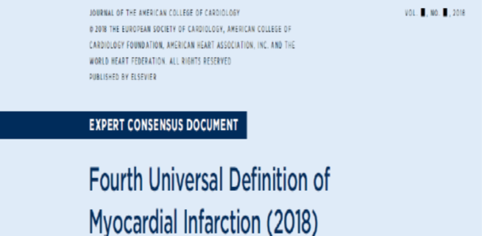
Cinética de las troponinas: IAM/ lesión miocardica
Factores biológicos que afectan las concentraciones de Tn´s:
Genero
Edad
Función renal

Slide 8
Algoritmo T0 (Tn´s indetectables en la admisión)
Metaanálisis (11 estudios) demostró que concentraciones < LoD (<5 ng/l) junto con un ECG sin signos de isquemia excluye el diagnóstico de IAM con sensibilidad del 98,7%
Precaución: Si el tiempo de evolución es desconocido o si el paciente presenta dolor de menos de 2 horas.
Este algoritmo no se puede utilizar con todos los métodos
Consecuencia de los algoritmos rápidos:
1.-Obviar pruebas complementarias no invasivas 2.-Acortar el tiempo de toma de decisiones y la estancia en el servicio de urgencias

Slide 9
Algoritmo T0/T3-h. hsTn´s
Consideraciones:
Un valor de Tn´s < p99 no descarta isquemia miocárdica, la angina inestable es un SCA sin daño miocárdico.
Si existe alta sospecha de isquémica miocárdica debe valorarse la realización de mas pruebas para descartar otras causas

Slide 10
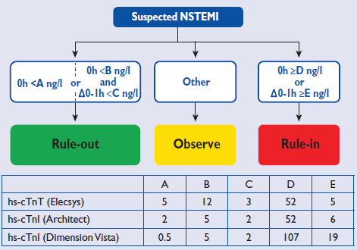

Algoritmo ESC T0/T1-h.hsTn´s
Pacientes con sospecha de NSTEMI en el SU
Consideraciones:
3 metodos de hsTn´s están validados: TnThs de Roche y hsTnI de Abbott y Siemens.
VPN dependerá del tiempo de evolución del IAM
En el grupo de pacientes en la zona observacional supone no menos del 20%
*
cTnT-hs (Elecsys)
  *Only applicable if chest pain onset > 3h
Notes:
Reichlin T et al., Arch Intern Med 2012;172:1211–1218
Rubini Gimenez M et al. , Int J Cardiol 2013;168:3896–3901
Body R et al., J Am Coll Cardiol 2011;58:1332–1339
Bandstein N et al., J Am Coll Cardiol 2014;63:2569–2578
Zhelev Z et al., BMJ 2015; 350:h15
Reichlin T et al., CMAJ 2015;187:E243–E252
Rubini Gimenez M et al., Am J Med 2015;128:861–870.e4

Slide 11
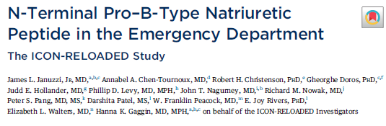
Marcadores cardiaco: Péptidos natriuréticos

Slide 12
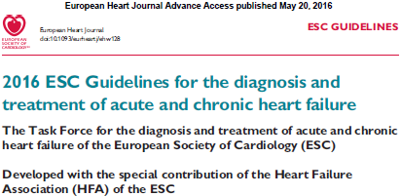
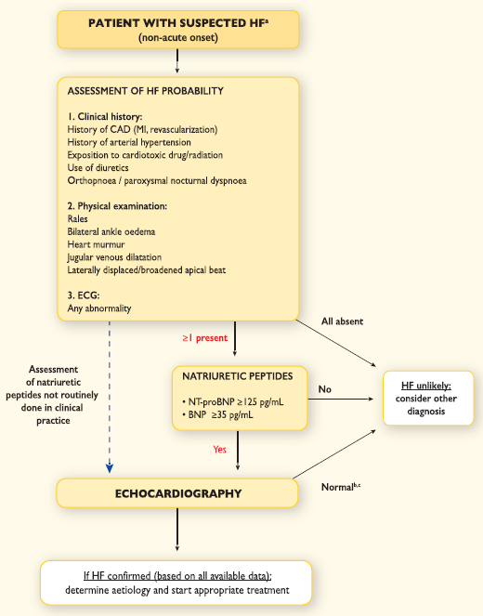
Diagnóstico
Rule out/agudo
Rule out/crónico
NT-proBNP
<300 pg/ml
NT-proBNP
<125 pg/ml
BNP
<100/pg/ml
BNP
< 35pg/ml
MR-proANP
<120pmol/L

Slide 13
The Value of NT-proBNP for the Evaluation of Acute CHF: International Collaborative of NT-proBNP (ICON) Study
ICON
ICON RELOADED
Januzzi J L, et al. J Am Coll Cardiol 2018;71:1191-200
European Heart Journal 2006,27,330-337
Category | Cut-off pg/ml | Sens | Spec | PPV | NPV
Rule in
<50 years (n=183) | 450 | 97% | 93% | 76% | 99%
50-75 years (n=554) | 900 | 90% | 82% | 82% | 88%
>75 years (n=519) | 1800 | 85% | 73% | 92% | 55%
Rule in, overall |  | 92% | 84% | 86% | 66%
Rule out
All patients (n=1256) | 300 | 99% | 60% | 77% | 98%
Category | Cut-off, pg/mL |  | Sensitivity | Specificity | PPV | NPV | LR+ | LR-
Confirmatory (“rule-in”) cutpoints
<50 y (n=462) |  | 450 | 85.7 (74.1-97.3) | 93.9 (91.6-96.2) | 53.6 (43.7-63.2) | 98.8 (97.3-99.4) | 14.08 (8.48-19.67) | 0.15 (0.03-0.28)
50-75 y (n=833) |  | 900 | 79.3 (73.5-85.2) | 84.0 (81.2-86.8) | 58.4 (53.7-63.0) | 93.5 (91.5-95.0) | 4.95 (4.00-5.90) | 0.25 (0.18-0.32)
>75 y (n=166) |  | 1,800 | 75.9 (64.8-86.9) | 75.0 (66.8-83.2) | 62.0 (53.3-70.0) | 85.3 (78.4-90.2) | 3.03 (1.94-4.13) | 0.32 (0.17-0.47)
Rule-in, overall (n=1,461) |  |  | 79.4 (74.7-84.2) | 86.7 (84.8-88.7) | 58.4 (54.5-62.1) | 94.7 (93.5-95.8) | 5.99 (5.05-6.93) | 0.24 (0.18-0.29)
Exclusionary (‘rule-out’) cutpoint
All patients (n=1,461) |  | 300 | 93.9 (91.0-96.7) | 71.7 (69.1-74.3) | 43.7 (41.4-46.1) | 98.0 (96.9-98.8) | 3.32 (3.00-3.63) | 0.09 (0.05-0.13)

Slide 14
The Value of NT-proBNP for the Evaluation of Acute CHF:
International Collaborative of NT-proBNP (ICON) Study. ICON RELOAD
 | Sensitivity | Specificity | PPV | NPV | AUC | P value for difference in AUC
Patients with eGFR <60.0 mL/min/1.73 m² | 89.3 (84.0-94.6) | 68.3 (61.6-75.0) | 66.5 (61.4-71.2) | 97.3 (90.1-99.3) | 0.872 | 0.12
Patients with eGFR ≥60.0 mL/min/1.73 m² | 70.3 (62.7-77.9) | 89.6 (87.6-91.7) | 51.9 (46.3-57.4) | 98.1 (96.8-98.8) | 0.907
Patients with body mass index <30.0 kg/m² | 90.3 (84.8-95.7) | 85.0 (81.9-88.0) | 56.4 (51.1-61.5) | 100.0 (-) | 0.946 | 0.001
Patients with body mass index ≥30.0 kg/m² | 72.1 (65.0-79.2) | 87.0 (84.2-89.8) | 60.7 (54.9-66.1) | 96.2 (94.1-97.6) | 0.896
Male | 80.5 (74.5-86.4) | 84.8 (81.9-87.8) | 61.0 (56.0-65.8) | 97.5 (95.5-98.6) | 0.908 | 0.44
Female | 77.8 (69.9-85.6) | 88.5 (86.0-91.1) | 54.5 (48.5-60.5) | 98.5 (97.0-99.3) | 0.922
Black | 82.4 (73.8-91.1) | 90.4 (87.7-93.2) | 58.7 (51.2-65.8) | 98.7 (97.0-99.4) | 0.933 | 0.16
Nonblack | 78.7 (73.0-84.4) | 84.5 (81.9-87.2) | 58.5 (53.9-62.9) | 97.9 (96.2-98.8) | 0.908
Presence of atrial fibrillation | 87.2 (80.5-94.0) | 56.6 (47.8-65.4) | 60.7 (55.5-65.8) | 100.0 (-) | 0.807 | <0.001
Absence of atrial fibrillation | 75.6 (69.3-81.8) | 90.4 (88.6-92.1) | 57.1 (52.1-62.0) | 98.0 (96.8-98.7) | 0.918
Patients with HFrEF | 90.8 (85.1-96.5) | 38.6 (24.2-53.0) | 76.7 (72.1-80.8) | 75.0 (38.7-93.5) | 0.646 | 0.11
Patients with HFpEF | 72.6 (61.5-83.7) | 68.6 (58.8-78.4) | 62.5 (54.1-70.2) | 80.4 (68.2-88.7) | 0.758
Januzzi J L, et al. J Am Coll Cardiol 2018;71:1191-200

Slide 15
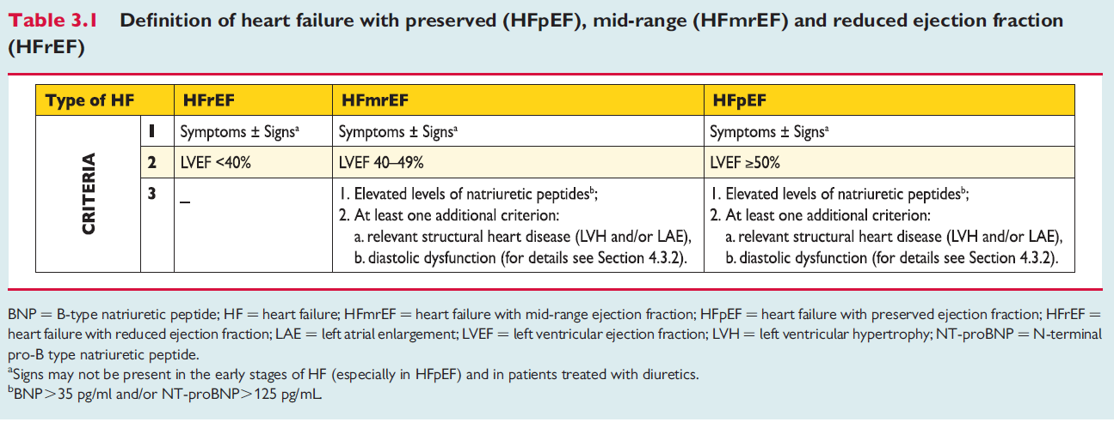

Slide 16
2017 ACC/AHA/HFSA Heart Failure: NP’s & troponin for prognosis and added risk stratification:
COR | LOE | Recommendation
I | A | Measurement of BNP or NT-proBNP is useful for establishing prognosis or disease severity in chronic HF
I | A | Measurement of baseline levels of natriuretic peptide biomarkers and/or cardiac troponin on admission to the hospital is useful to establish a prognosis in ADHF
High levels of NPs on admission are usually associated with greater risk for clinical outcomes: all-cause and CV mortality, morbidity, composite outcomes, across different time intervals in ADHF Abnormal levels of cTn commonly found in ADHF, often without obvious myocardial ischemia or underlying CAD, and this is associated with worse clinical outcomes and higher risk of death
10.1016/j.jacc.2017.04.025
* Are referenced here only the NT-proBNP ones, not BNP or other NPs

Slide 17
2017 ACC/AHA/HFSA Heart Failure Focused
NP’s & troponin for prognosis and added risk stratification
COR | LOE | Recommendation
IIa | B-NR | During a HF hospitalization, a predischarge natriuretic peptide level can be useful to establish a postdischarge prognosis
IIb | B-NR | In patients with CHF, measurement of other clinically available tests, such as biomarkers of myocardial injury or fibrosis, may be considered for additive risk stratification
Predischarge NP levels and the relative change in levels during hospital treatment are strong predictors of the risk of death or hospital readmission for HF . Predischarge NP levels had higher reclassification and discrimination value than clinical variables. Biomarkers of myocardial fibrosis (ST2, Gal-3, hsTnT and others) are predictive of hospitalization and death in patients with HF and also are additive to NPs in their prognostic value
10.1016/j.jacc.2017.04.025
Notes:
Patients with higher predischarge levels and patients who do not have a decrease in NP levels during hospitalization have worse outcomes

Slide 18
ACC/AHA
Stage A/B HF
ACC/AHA
Stage C/D HF
ACC/AHA
Acute/Hospitalized HF
At risk for HF
Ambulatory pts with new-onset dyspnea
NYHA II-IV
Acute dyspnea to ED
Hospitalized for ADHF
Prevention
BNP or NT-proBNP
(COR IIa)
Diagnosis
BNP/NT-proBNP (COR I A)
BNP/NT-proBNP (COR IA)
Prognosis or added risk stratification
BNP/NT-proBNP (COR IA)
BNP/NT-proBNP and cardiac troponin (COR IA)
Predischarge BNP/NT-proBNP (COR IIa B-NR)
Other biomarkers of myocardial injury or fibrosis (COR IIb)
Other biomarkers of myocardial injury or fibrosis (COR IIb)

Slide 19
Diagnóstico de IC
Monitorización del pronóstico durante el tratamiento de la IC
Estratificación del riesgo: Embolia pulmonar, neumonía y riesgo preoperatorio en cirugía cardiaca
Puntos claves

Slide 20
Diagnóstico de IC
Disnea y/o fatiga
European Journal of Heart Failure (2019) 21, 715-731

Slide 21
Diagnostico de IC: Consideraciones especiales
Enfermedad Renal
25% eliminación renal
BNP: Rule-out, 200
NT-proBNP: correlación entre IR y edad, no es necesario modificar el valor de cut-off al utilizar cut-off ajustados por edad
No suficientes datos en hemodiálisis
Arritmias auriculares
FA ( y Flutter) se asocian a concentraciones mas elevadas de PN
Pacientes tratados con sacubitril/vasartan
NT-proBNP de elección para cuantificar la severidad de IC y monitorizar el pronóstico
European Journal of Heart Failure (2019) 21, 715-731

Slide 22
Monitorización del pronostico durante el tratamiento
PN tienen valor pronóstico después del tratamiento
Valores bajos al alta del paciente tienen mejor pronóstico que concentraciones elevadas de los mismos
Mayores reducciones relativas durante el tratamiento
Los valores de los PN al alta parece ser el mejor predictor de muerte o rehospitalizaciones al año en los pacientes con IC aguda, superior al valor de los péptidos
En la admisión
Al cambio de los valores entre la admisión y el alta
European Journal of Heart Failure (2019) 21, 715-731

Slide 23
Principales claves para el uso de los péptidos natriureticos
1.-Diagnóstico
Utilizar junto a información clínica
Pacientes con signos sugestivos de IC tales como disnea y/o fatiga
Diferencia la IC de la disnea de otro origen
Los PN están mas elevados en pacientes con disnea aguda que en los pacientes con IC crónica
Pacientes obesos valores de PN menores, cut-off 50% menor
2.-Pronóstico
En pacientes con IC estable, pacientes con IM ,enfermedad valvular, FA etc…., los péptidos tienen valor pronostico: muerte y hospitalización por IC
3.-Screening
Para la detección temprana de enfermedad cardiaca incluyendo disfunción sistólica del VI en pacientes con factores de riesgo CV pueden identificar pacientes con riesgo elevado permitiendo medidas preventivas para prevenir la IC
European Journal of Heart Failure (2019) 21, 715-731

Slide 24

Marcadores cardiacos: Utilidad clínica del biomarcador GDF-15
M. Jose Ramírez
21/10/2019

Slide 25
GDF-15 – stress-responsive member of the TGFβ cytokine superfamily
Marcadores cardiacos: GDF-15
Conditions associated with higher GDF-15 levels
Higher age
Current smoking
Diabetes mellitus (metabolic syndrome)
Genetic factors
Acute inflammation (e.g. sepsis)
Chronic inflammation (e.g. rheumatoid arthritis)
Chronic kidney disease
Anemia and bleeding
Vascular disease
Heart failure
Atrial fibrillation
Solid cancers
Terminal illness, cachexia
Increases in response to stress signals¹⁻²
  Hypoxia
  Oxidative stress
  Inflammation
  Tissue injury
  Remodelling
Weakly expressed under healthy conditions
Wollert KC, et al. Clin Chem 2017;63:140-5
¹Kempf T, et al. Circ Res, 2006;98:351–60; ²Frank D, et al. Hypertension, 2008;51:309–18.
Notes:
GDF-15 – stress-responsive member of the TGFβ cytokine superfamily - high levels in the placenta¹
Expression increases sharply in response to pathological or environmental stress signals:^{2,3}
hypoxia
oxidative stress
inflammation
tissue injury
Remodelling

Slide 26
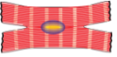
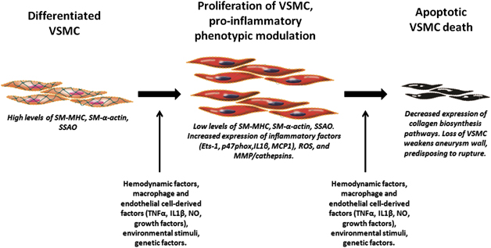
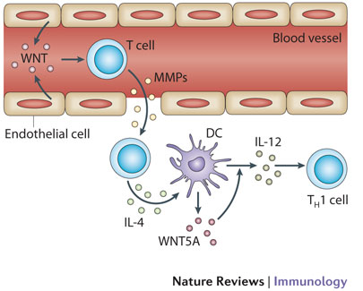
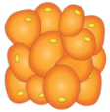
Marker biology
GDF-15 – stress-responsive member of the TGFβ cytokine superfamily
Several independent pathways of GDF-15 expression depend on tissue, cellular and signalling contexts¹
Inflammatory cytokines
Oxidized LDL
Oxidative stress
Mechanical stretch
Oxidative stress
Ischaemia / reperfusion
Pressure overload
Heart failure
Cardiac myocytes
Vascular Smooth Muscle Cells
Macrophages
Endothelial Cells
Adipocytes
GDF-15
LAD, left anterior descending coronary artery; TGFβ, transforming growth factor β
¹Corre J, et al. Stem Cells Transl Med, 2013; 2:946–52;
Notes:
Cultivo de miocitos: Isquemia, stretch, activación neurohormonal, citoquinas proinflamatorias
Celulas del musculo liso

Slide 27
Procesos moleculares en la patología de IC
Stress miocardio
sST2
PN
Inflamación
sST2
GDF-15
Matrix y
remodelado celular
sST2
GDF-15
Notes:
Biomarcadores se clasifican en función del proceso en el cual están implicados en el desarrollo y progresión de la IC
Papel en el remodelado cardiaco protegiendo al miocito contra apoptosis y la hipertrofia

Slide 28
Insuficiencia cardiaca: Pronóstico

Slide 29
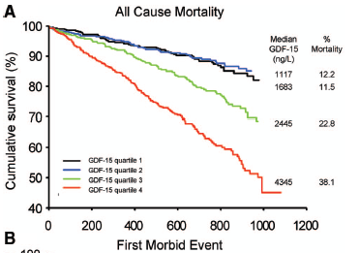
GDF-15 strongly predicted outcomes in the Val-HeFT study
prognostic value beyond that of established risk factors
Survival according to GDF-15 levels in CHF patients
n=1,517
Patients with GDF-15 levels in the highest two quartiles had:
  poorest all-cause mortality
  shorter time to first morbid event
GDF-15 added incremental prognostic value to that of a comprehensive panel of clinical and laboratory parameters
BNP, B-type natriuretic peptide; CHF, chronic heart failure; Val-HeFT, valsaratan heart failure
Anand IS, et al. (2010). Circulation, 122:1387–95.
Days
Notes:
1. Anand IS, et al. (2010). Circulation, 122:1387–95c
GDF-15 concentration in serum and plasma samples was determined with an immunoradiometric assay with a polyclonal, GDF-15 affinity chromatography-purified, goat anti-human GDF-15 IgG antibody from R&D Systems (Minneapolis, Minn) (AF957)
Evidence from the Val-HeFT study
GDF-15 was a strong predictor of survival also in the Val-HeFT study
Quartiles of GDF-15 showed a similar prediction of survival in chronic heart failure as compared to the study by Kempf. The relatively high survival rate was similar in the two lower quartiles of GDF-15 as also seen in the other study.
GDF-15 levels were independently associated with mortality in multi-variable Cox-regression models: GDF-15 provided additional prognostic information on top of that provided by:
recognized clinical prognostic variables (age, gender, presence of ischemic heart disease, NHYA class, orthopnea, diabetes mellitus, body mass index, systolic blood pressure, heart rate, atrial fibrillation, LVEF, hemoglobin, serum sodium, albumin, uric acid, eGFR, use of an angiotensin-converting enzyme inhibitor, B-blocker, diuretic, digoxin, spironolactone, and the Val-HeFT treatment allocation (model 1).
Laboratory parameters (BNP, hs-CRP, and hs-TnT, transformed with natural logarithms (model 2).
29

Slide 30
Role of other biomarkers in out-patient monitoring/HF
Prognostic role of GDF-15 beyond NYHA class, LVEF and NT-proBNP
One-year mortality rates according to NYHA functional class, LVEF, NT-proBNP, and levels of GDF-15 (n=455)
HR 5.1
(2.1–12.4)
HR 5.1
(2.4–10.8)
HR 3.5
(1.6–7.6)
HR 9.2
(1.9–44.0)
HR 3.5
(0.9–13.1)
HR 6.2
(1.3–30.8)
NYHA class
LVEF
NT-proBNP
HR, hazard ratio; LVEF, left ventricular ejection fraction; NYHA, New York Heart Association
Kempf et al. JACC 2007;11:1054-60.

Slide 31
Síndrome Coronario Agudo: Pronóstico

Slide 32
GDF-15 in risk stratification for patients with ACS
Strongly predict:
mortality,
reinfarction,
other adverse CV outcomes
Composite endpoint of CV death, spontaneous MI, or stroke after 12 months by circulating GDF-15 levels
GDF-15 levels
0.4
Median
25th
75th
Predictive value is independent of established risk factors including TnT-hs and NT-proBNP
0.3
Probability of CV death, spontaneous MI or stroke
0.2
Levels continue to predict adverse outcomes in ACS patients for several years after clinical stabilization
0.1
Event rate
95% CI
0
1,000
2,000
4,000
6,000
9,000
GDF-15 (pg/mL)
Wollert KC, et al. Clin Chem 2017;63:140–51.

Slide 33
GDF-15 levels predict mortality and reinfarction in ACS
independent of established risk factors (including NT-proBNP)
Mortality according to GDF-15 tertiles (NSTE-ACS; GUSTO IV)¹
Mortality according to GDF-15 tertiles (STEMI; ASSENT-2/plus)³
Reinfarction according to GDF-15 tertiles (NSTE-ACS patients managed non-invasively; FRISC II)²
n=2,018
n=730
n=2,079
0.15
16
25
12
20
0.10
p<0.001
15
Cumulative mortality
Mortality (%)
Recurrent MI (%)
8
p<0.001
p<0.001
10
0.05
4
5
0
0
0
0
3
6
9
12
0
3
6
9
12
0
6
12
18
24
Time (months)
Time (months)
Time (months)
GDF-15 (ng/L):
<1200
1200–1800
>1800
1. Wollert KC, et al. (2007). Circulation, 115:962–71; 2. Wollert KC, et al. (2007). Circulation, 116:1540–8; 3. Kempf T, et al. (2007). Eur Heart J, 28:2858–65.
Notes:
GDF-15 concentration in serum and plasma samples was determined with an immunoradiometric assay with a polyclonal, GDF-15 affinity chromatography-purified, goat anti-human GDF-15 IgG antibody from R&D Systems (Minneapolis, Minn) (AF957)

Slide 34
GDF-15 as bleeding risk marker in ACS
ESC Barcelona 2017
Growth differentiation factor 15 and bleeding risk with ticagrelor in patients with prior myocardial infarction: insights from PEGASUS-TIMI 54
M. Bonaca (Brigham and Women's Hospital, Medicine, Cardiology, Vascular Medicine - Boston - United States of America)
Adj HR (95% CI)
For each
Quartile vs. Q1
P-trend 0.0023
Adj HR (95% CI)
For each
Quartile vs. Q1
P-trend 0.013
Key messages
Strong graded relationship between baseline
GDF­15 and the risk of major bleeding at 3 years
Adjusted risk of major bleeding was nearly
4­-fold higher in highest vs. lowest quartile of GDF­15
GDF-15 may be useful to profile bleeding risk in patients being
considered for long term treatment with ticagrelor
Adj HR (95% CI)
For each
Quartile vs. Q1
P-trend 0.75
Q1
Q2
Q3
Q4
Quartiles of GDF-15 at Baseline
Q1 | Q2 | Q3 | Q4
≤913 pg/mL | >913 - ≤1241 pg/mL | >1241 - ≤1775 pg/mL | >1775 pg/mL
N=2156 | N=2155 | N=2157 | N=2152
Notes:
Figure:
Mice were subjected to permanent or transient LAD ligation (not shown). Permanent coronary artery ligation resulted in a rapid induction of GDF-15 expression in the ischemic area; mRNA levels were upregulated within 1 hour (not shown) and pro-peptide levels within 5 hours (Figure).
With time, GDF-15 mRNA and pro-peptide expression continued to increase in the ischemic area and remained elevated for at least 7 days.
the Thrombolysis in Myocardial Infarction (TIMI) criteria,define major bleeding as an intracranial haemorrhage, a decrease in hematocrit of 15% or a 5 g/dl decrease in the haemoglobin concentration.

Slide 35
Fibrilación auricular: Predictor de riesgo de sangrado

Slide 36
GDF-15: Physiologic role in bleeding
Prevents platelet integrin activation and platelet aggregation
Higher levels are associated with increased bleeding times
WT mice pre-treated with recombinant GDF-15
ADP
U46619
Bleeding time (s)
210
*
*P<0.05
GDF-15 20ng mL⁻¹
GDF-15 20ng mL⁻¹
180
150
*
120
Aggregation
GDF-15 10ng mL⁻¹
Aggregation
GDF-15 10ng mL⁻¹
90
60
Control
Control
30
0
WT
GDF-15^{-/-}
WT
+GDF-15
WT, wild type
Rossaint J, et al. J Thromb Haemostasis 2013;11:335-44.
Notes:
Integrinas y el U46619 favorecen la agregación plaquetaria al igual que el tromboxano. Integrinas receptores de membrana de la plaqueta.-GDF-15 evita la activación de las integrinas plaquetarias
Plaquetas liberan ADP que favorecen la agregación de mas plaquetas

Slide 37
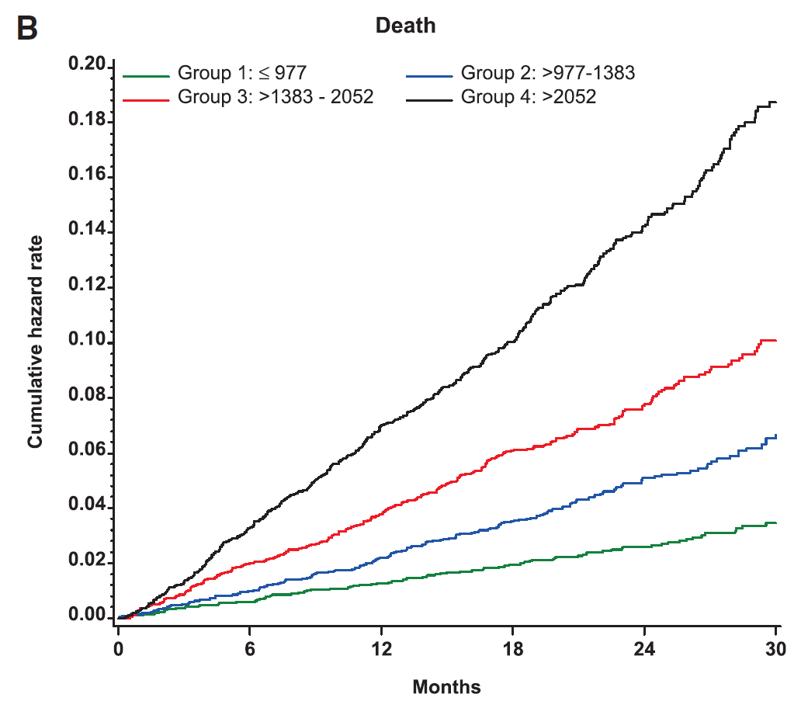
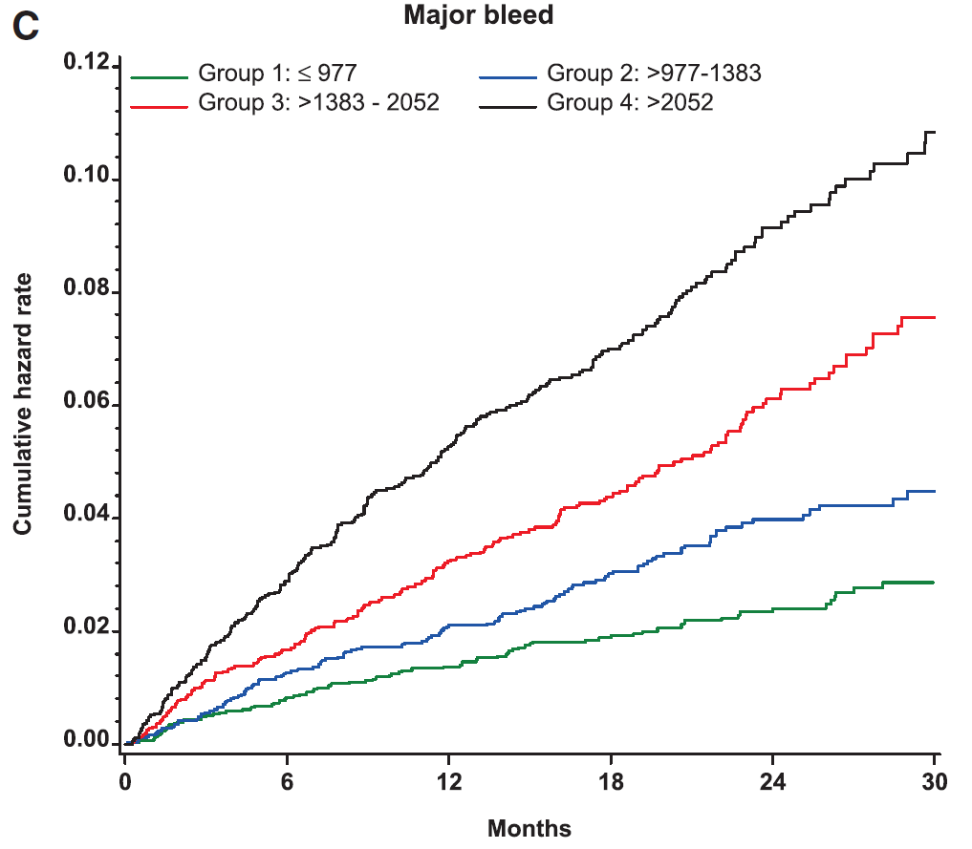
GDF-15 the strongest predictor of bleeding in AF
ARISTOTLE study
82 different biomarkers measured
14 798 AF patients
Strongest independent predictor of bleeding from all tested biomarkers
Cumulative hazard rate of death or major bleed according to GDF-15 quartile (n=14 798)
Death
Major bleed
GDF-15
1.34%
mortality
7.19%
1.22%
major bleeding
4.53%
0.9%
stroke/systemic embolism
2.03%
  *p<0.001 for all comparisons
ARISTOTLE, Apixaban for Reduction in Stroke and Other Thromboembolic Events in Atrial Fibrillation
Wallentine L, et al. (2014). Circulation, 130:1847–58.
Notes:
n=14 798; Median age 64 yrs; Gender, male 65.3%
AF patients with baseline GDF-15 in the highest quartile had significantly higher rates of stroke or systemic embolism (2.03% vs. 0.9%), major bleeding (4.53% vs. 1.22%), and mortality (7.19% vs. 1.34%), compared with those with GDF-15 in the lowest quarter (p<0.001 for all comparisons)
The prognostic value of GDF-15 was independent of clinical characteristics and clinical risk scores
La adición de GDF-15 a módelos de estratificación de riesgo (chad2 ds2vasc y HASBLED mejora la valoración del riesgo de sangrado y mortalidad
GDF-15 mejora la estratificación del riesgo de sangrado y mortalidad mas alla de los factores de riesgo clinico y biomarcadores en pacientes anticoagulados con FA

Slide 38
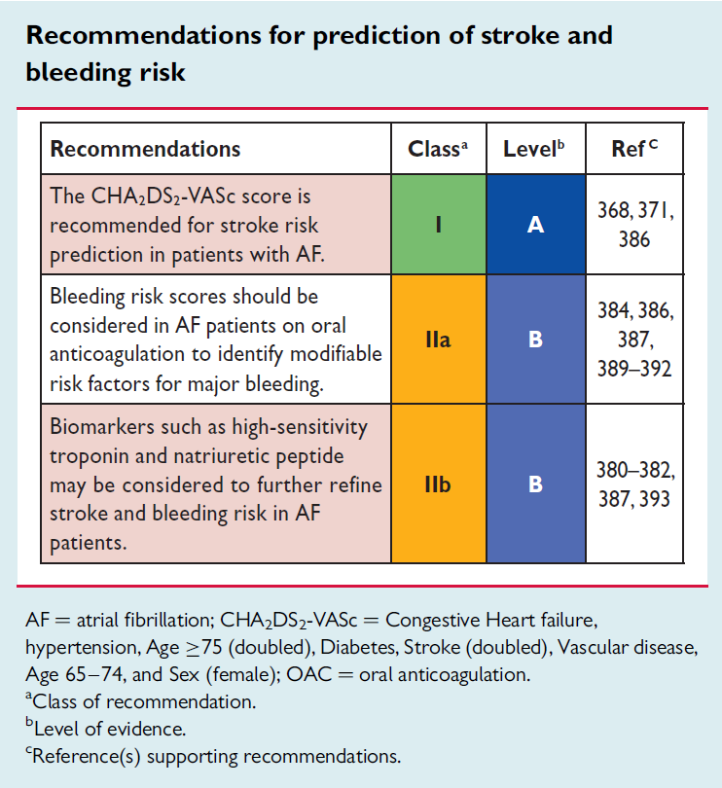
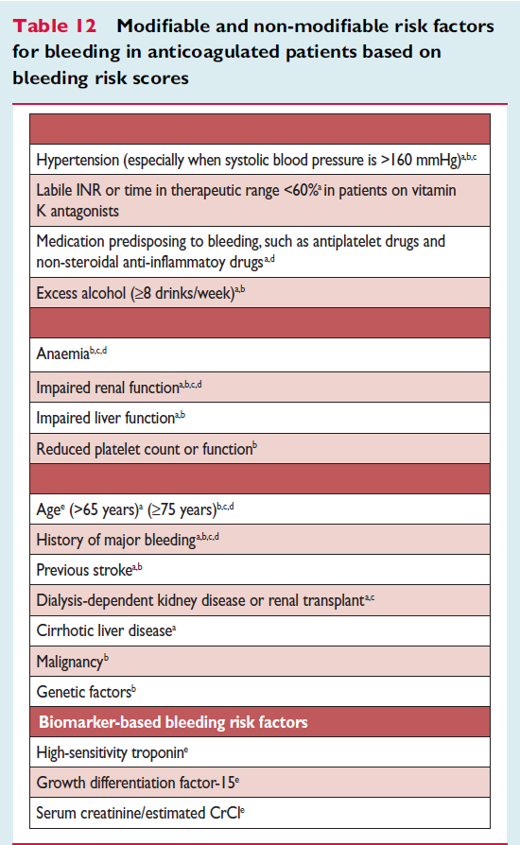
2016 ESC AF guidelines
Incorporating GDF-15 and ABC bleeding risk score
Kirchhof P et al (2016). Eur Heart J 37(38):2893-2962.

Slide 39

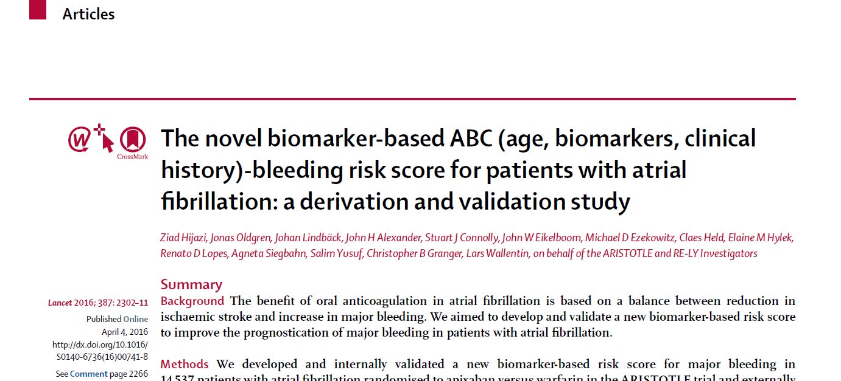
Hijaz Z, et al. (2016). Lancet 2016; 387(10035):2302-11.

Slide 40
ABC-bleeding risk score
Incorporating GDF-15 biomarker into AF bleeding risk score
Age
Biomarkers
Clinical history
Includes the most important variables for major bleeding
GDF-15
Troponin T
Age
Haemoglobin
Previous bleeding
Contains 91.3% of the prognostic information provided by all included clinical and biomarker variables.
GDF-15
Troponin T
Age
Haemoglobin
Previous bleeding
CHF
Cystatin C
Haematocrit
Previous stroke or TIA
Hypertension
Sex
Previous MI
Alcohol
Persistent or permanent AF
Previous PAD
Diabetes
Current smoker
Previous vascular disease
NT-proBNP
Supports physicians in tailoring stroke prevention in AF patients
0
5
10
15
20
χ² – df
Hijazi Z, et al. Lancet 2016;387:2302-2311.
Notes:
Niveles elevados de TnThs en FA están independientemente asociados con stroke, muerte cardiaca, sangrado mayor y mejora la estratificación del riesgo del score CHAD2DS2VASC
Desarrollado y validación interna en la cohort del studio Aristotle y validado externamente en la cohort del RELY study

Slide 41
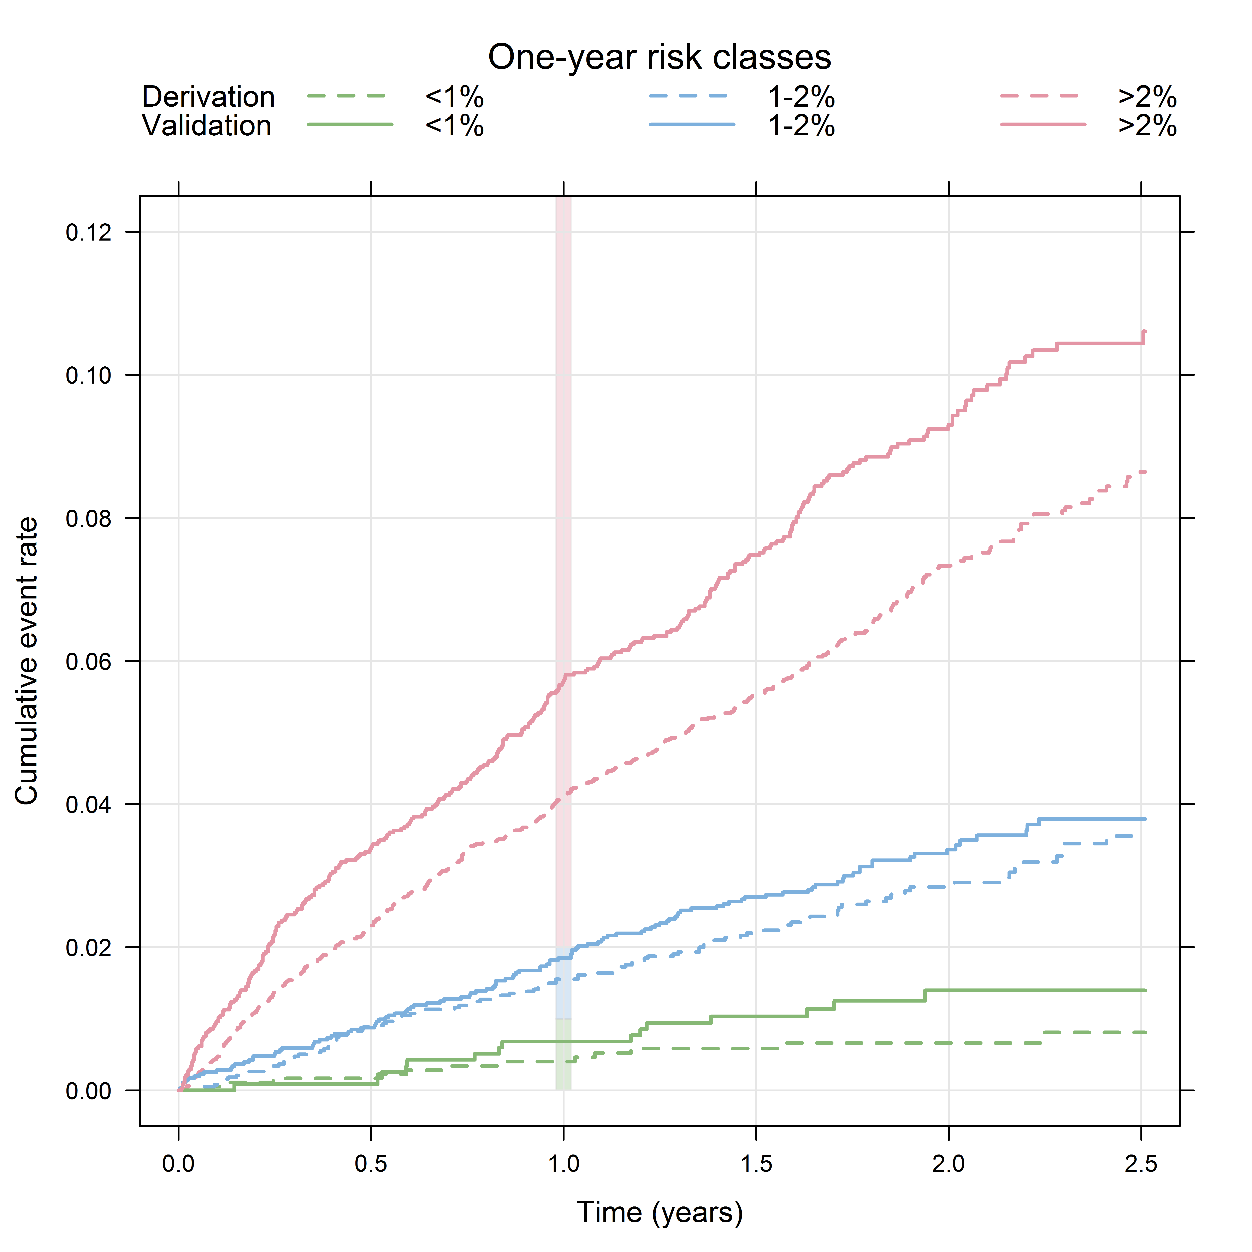
ABC-bleeding risk score well-calibrated
ABC-bleeding risk score was well calibrated:
One-year risk classes
Patients were accurately stratified in relevant risk groups according to event rate
Low | Med | High
Derivation cohort
Validation cohort
Comparison of event rates within risk classes for both cohorts shows that the ABC-bleeding score had good discriminative ability
Hijazi Z, Oldgren J, Lindbäck J, et al. Lancet 2016
Notes:
ABC-bleeding risk score was well calibrated:
Based on ABC-bleeding risk score, patients were accurately stratified in high risk, medium and low risk groups according to event rate, in both derivation and validation cohort
Comparison of event rates within risk classes for both the derivation and the validation cohorts shows that the ABC-bleeding score had good discriminative ability in different subgroups of patients with atrial fi brillation

Slide 42
Comparisons of ABC with other bleeding risk scores
Performance
C-indices [95% CI] for the ABC-bleeding and other scores in the derivation and validation cohorts:
 | Full cohort | No prior bleed | Warfarin | NOAC
Derivation cohort (n=14,537)
ABC-bleeding | 0.68 [0.66, 0.70] | 0.68 [0.65, 0.70] | 0.68 [0.65, 0.70] | 0.68 [0.65, 0.71]
HAS-BLED | 0.61 [0.59, 0.63] | 0.60 [0.58, 0.63] | 0.61 [0.58, 0.63] | 0.61 [0.57, 0.64]
ORBIT | 0.65 [0.62, 0.67] | 0.65 [0.62, 0.67] | 0.65 [0.62, 0.68] | 0.64 [0.61, 0.68]
External validation (n=8,468)
ABC-bleeding | 0.71 [0.68, 0.73] | 0.68 [0.66, 0.71] | 0.65 [0.61, 0.70] | 0.74 [0.71, 0.76]
HAS-BLED | 0.62 [0.59, 0.64] | 0.57 [0.55, 0.60] | 0.60 [0.56, 0.64] | 0.62 [0.59, 0.65]
ORBIT | 0.68 [0.65, 0.70] | 0.64 [0.61, 0.67] | 0.63 [0.58, 0.67] | 0.70 [0.67, 0.73]
ABC-bleeding score also achieved higher c-index compared with the HAS-BLED and ORBIT scores in multiple subgroups—ie, in patients without a history of bleeding, in patients on concomitant antiplatelet or NSAID therapy, as well as in patients randomly assigned to warfarin
ABC-bleeding score performed equally well in patients treated with warfarin or apixaban without any significant interaction with the effects of the randomised treatment
NOAC: derivation cohort = apixaban, external validation cohort = dabigatran\
Hijazi Z, Oldgren J, Lindbäck J, et al. Lancet 2016
Notes:
C-statistic is also known as Area Under the Curve (AUC) when using Receiver Operating Characteristic (ROC) curve. In this prospective, C-statistic has a range between 0.5 to 1.00. The higher the value of C-statistics the better the predictability of the model (the stronger the positive-association between the event and the risk). The classifying strength of C-statistics or (AUC) is roughly as in the following: 0.90-1.0 = excellent (A), 0.80-0.90 = good (B), 0.70-0.80 = fair (C), 60-0.70 = poor (D), and 0.50-0.60 = very poor/almost no association (F).

Slide 43
Major bleeding risk stratification with HAS-BLED and ORBIT
A
HAS-BLED: 0-1
A
HAS-BLED: 2
A
HAS-BLED: ≥3
0.12
0.12
0.12
ABC-score bleeding risk classes
0.08
0.08
0.08
Cumulative event rate
0.04
0.04
0.04
<1%
1-2%
>2%
0
0
0.5
1.0
1.5
2.0
2.5
0
0
0.5
1.0
1.5
2.0
2.5
0
0
0.5
1.0
1.5
2.0
2.5
Number at risk
Time (years)
Time (years)
Time (years)
>2%
1-2%
<1%
4899
4439
2406
4383
4189
2283
4058
4040
2211
3204
3385
1885
1681
1946
1150
766
887
538
4960
2390
535
4400
2264
505
4102
2190
492
3252
1846
423
1695
1024
262
727
410
126
2578
683
115
2265
654
112
2090
629
108
1647
537
94
816
292
48
333
127
18
B
B
B
Cumulative rates of major bleeding by ABC-bleeding risk classes in the HAS-BLED (A) and ORBIT (B) scores.
Kaplan-Meier estimated cumulative event rate by the three ABC-bleeding risk classes (low, medium, and high) for the HAS-BLED score (0-1 points, 2 points, and 3 points; A) and for the ORBIT score (0-2 points, 3 points, and 4 points; B).
0.16
ORBIT: 0-2
0.16
ORBIT: 3
0.16
ORBIT: ≥4
0.12
0.12
0.12
Cumulative event rate
0.08
0.08
0.08
0.04
0.04
0.04
0
0
0.5
1.0
1.5
2.0
2.5
0
0
0.5
1.0
1.5
2.0
2.5
0
0
0.5
1.0
1.5
2.0
2.5
Number at risk
Time (years)
Time (years)
Time (years)
>2%
1-2%
<1%
7283
6704
2876
6573
6347
2725
6161
6129
2640
4918
5147
2255
2551
2887
1363
1179
1271
645
2405
504
85
2120
470
80
1959
451
77
1547
370
59
778
224
41
305
99
22
2597
119
24
2210
111
24
1991
103
23
1507
82
21
780
53
16
313
21
8
Hijazi Z, et al. Lancet 2016;387:2302-2311.

Slide 44
Notes:
El score de riesgo ABC bleeding estratifica exactamente los pacientes independiente de las categorías del score de riesgo HAS-BLED

Slide 45
Qué aportan los marcadores bioquimícos en el manejo de la enfermedad cardiovascular? Conclusión
Estratificación del riesgo de los pacientes
Ayuda al diagnóstico
Añaden valor pronostico al ofrecido por los factores de riesgo establecidos
Mejora la prediccion de eventos, junto a las variables clinicas
Intensificar el tratamiento farmacologico
Seleccionar un mejor tratamiento para el paciente
Derivar al paciente a diferentes niveles asistenciales

Slide 46
Doing now what patients need next

